Slide 1








DIGITAL. INNOVATION. SCALE

Slide 2

Agenda
Abstract Factory Design Pattern
What is Abstract
When to use
Examples
+/-
What we need
Questions and answers

Slide 3
What is Abstract Factory Design Pattern
Creational Design Pattern
Provide an interface for creating families of related or dependent objects without specifying their concrete classes.
How can a class be independent of how the objects it requires are created?
How can different families of related or dependent objects be created?
Provide an interface for creating families of related or dependent objects without specifying their concrete classes

Slide 4
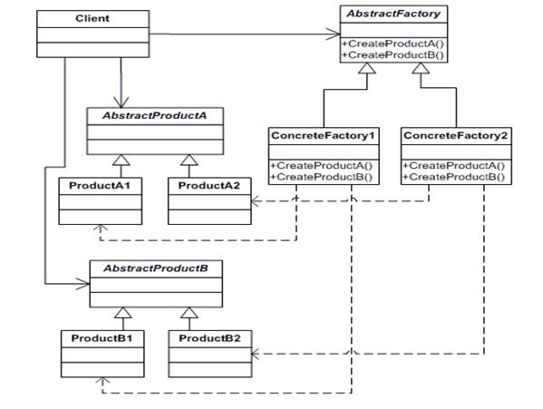
Example

Slide 5
Example
public class Product1
{
public Part1 Part1 { get; set; }
}
public class ConcreteFactory1: IAbstractFactory
{
public Product1 GetProduct1
{
return new Product1();
}
public Product2 GetProduct2
{
return new Product2();
}
}
public class Product2
{
public Part2 Part2 { get; set; }
}
public class ConcreteFactory2: IAbstractFactory
{
public Product1 GetProduct1
{
return product1Factory.GetProduct();
}
public Product2 GetProduct2
{
return product2Factory.GetProduct();
}
}
public interface IAbstractFactory
{
Product1 GetProduct1();
Product2 GetProduct2();
}

Slide 6
public class UserConfiguration
{
public string Guid { get; set; }
public string Content { get; set; }
public Dictionary<string, string> MetaData
{ get; set; }
}
public class UserGridConfiguration
{
public string Guid { get; set; }
public string Name { get; set; }
public List<dynamic> Columns { get; set; }
public List<dynamic> Filters { get; set; }
}
public interface IGridConfigurationRepository
{
UserGridConfiguration GetReport();
void Save(UserGridConfiguration gridConfig);
List<UserGridConfiguration> GetAll();
}
Example
public interface IUserConfigurationRepository
{
UserConfiguration GetReport();
void Save(UserConfiguration userConfig);
}
public interface IRepositoryFactory
{
IUserConfigurationRepository GetUserConfigurationRepository();
IGridConfigurationRepository GetGridConfigurationRepository();
}

Slide 7
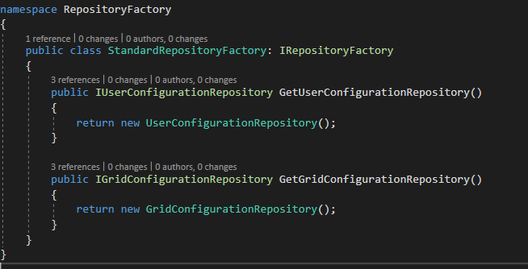
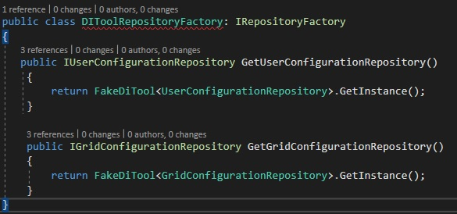
Example

Slide 8
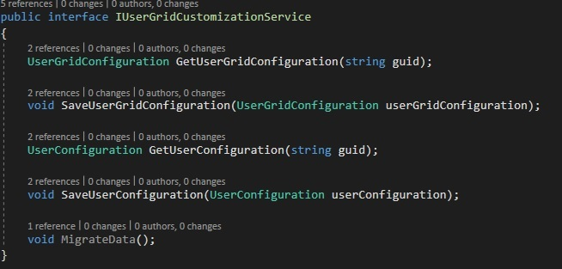
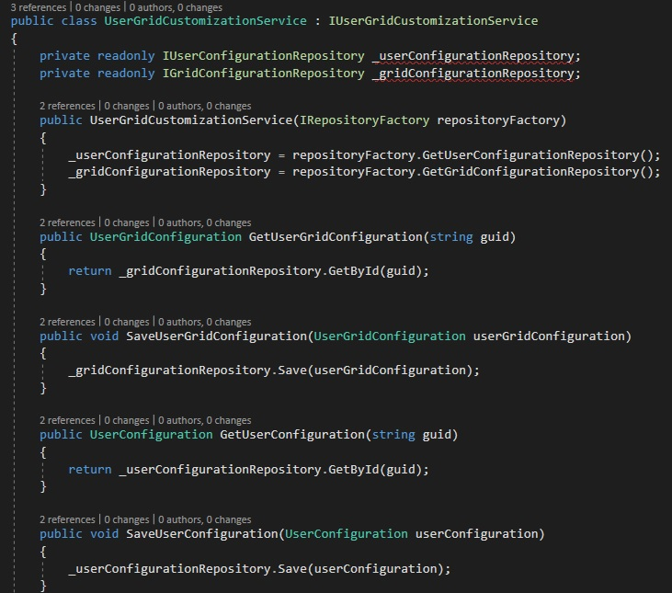
Example

Slide 9
Advantages
Advantages
Avoids compile-time implementation dependencies.
Instead of instantiating concrete classes directly, clients delegate instantiation to a separate factory object.
Ensures creating consistent object families.
When an application supports creating multiple families of related objects, it must be ensured that a family of related objects is created and used together.
Makes exchanging whole object families easy.
Because a factory object encapsulates creating a complete family of objects, the whole family can be exchanged by exchanging the factory object.

Slide 10
Disadvantages
Disadvantages
Requires extending the Factory interface to extend an object family.
The Factory interface must be extended to extend a family of objects (to support new kinds of objects).
Introduces an additional level of indirection.
The pattern achieves flexibility by introducing an additional level of indirection (clients delegate instantiation to a separate factory object), which makes clients dependent on a factory object.)

Slide 11
What we need
Participants
Factory – Abstract class/ Interface
Concrete Factory – Implements the interface class
Family of Products – The results
Client

Slide 12
Questions

Slide 13
References
GOF – Design Patterns - http://www.w3sdesign.com/GoF_Design_Patterns_Reference0100.pdf
Dotfactory - https://www.dofactory.com/net/design-patterns
C-Sharp corner - https://www.c-sharpcorner.com/article/abstract-factory-design-pattern-in-c-sharp/
Code example - https://gitlab.softvision.ro/enterprise.net/design-patterns/abstractFactory
https://github.com/svdcretu/designPatterns/tree/master/Creational

